Slide 1
Applet Programming
Unit - 4

Slide 2
Applet and Application
An applet is a special kind of Java program that runs in a Java enabled browser.
Applets can be run within any modern browser.
To create an applet, a class must class extends java.applet.Applet class.
To run Java applets, old browsers need an up-to-date Java plugin.
Appletviewer is used to execute applet program
In Java, non-applet programs are called applications.

Slide 3
Applet…
Advantage of Applet:
It works at client side so less response time.
Secured
It can be executed by browsers running under many platforms, including Linux, Windows, Mac Os etc.
Drawback of Applet:
Plugin is required at client browser to execute applet.

Slide 4
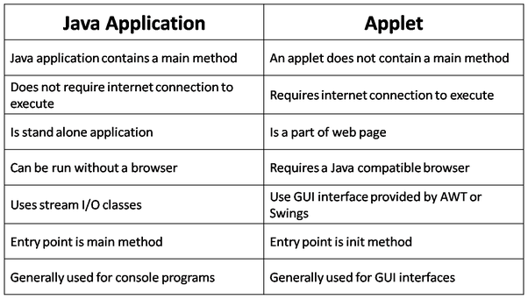
Application v/s Applet

Slide 5
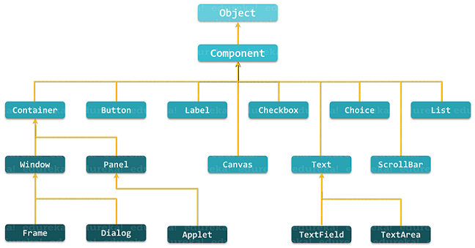
Hierarchy of Applet and AWT component classes

Slide 6
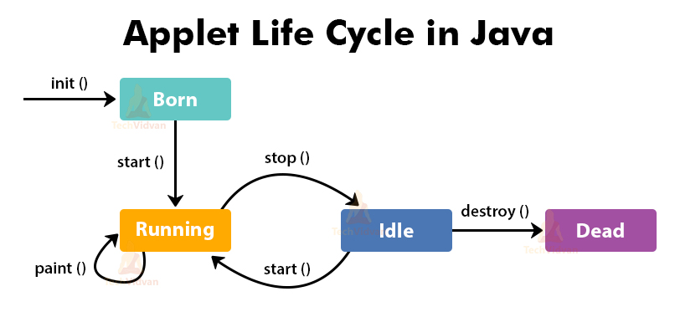
Life Cycle of Applet

Slide 7
Life Cycle…
Following methods are executed during life cycle of an applet.
init() :
It is used to initialized the Applet.
It is invoked when applet is first loaded.
It is invoked only once.
start() :
It is invoked after the init() method.
It is invoked when an applet is started or restarted.

Slide 8
Life Cycle…
paint() :
This method invoked immediately after the start() method.
It also called at any time when the applet needs to repaint itself in the browser.
stop() :
It is used to stop the Applet.
It is invoked when Applet is stop or browser is minimized.
destroy() :
It is used to destroy the Applet.
It is invoked only once.
It is invoked when the browser unloads the applet.

Slide 9
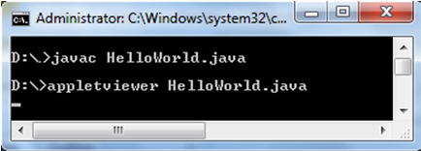
Simple Applet Program
import java.awt.*;
import java.applet.*;
/* <applet code="HelloWorld" width=200 height=100>
</applet> */
public class HelloWorld extends Applet
{ public void paint( Graphics g )
{
g.drawString( "Hello World!", 30, 30 );
}
}
Example of Life Cycle

Slide 10
<Applet> tag parameters
The HTML applet tag contains the following parameters:
<Applet code="name of .class file"
codebase="URL where code is loaded from"
name="applet identifier"
align="LEFT|RIGHT|CENTER
width="size in pixels"
height="size in pixels“>
<param name=“aName1” value=“aValue”>
<param name=“aName2” value=“aValue”>
</Applet>

Slide 11
Embedding Applet into HTML
<html>
<head>
<title>HTML applet Tag</title>
</head> <body>
<body>
<applet code="newClass.class" width="300" height="200"> </applet>
</body>
</html>

Slide 12
Graphics Class
Graphics class belongs into java.awt package.
Methods:
g.drawString(“Hello”, 20, 20);
g.drawRect(x, y, width, height);
g.fillRect(x, y, width, height);
g.drawOval(x, y, width, height);
g.fillOval(x, y, width, height);
g.setColor(Color.red);
Hello

Slide 13
Graphics Coordinate
(0,0)
x
height
y
width

Slide 14
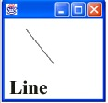
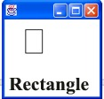

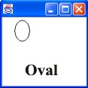
Line | g.drawLine(35, 45, 75, 95); drawLine(int x1, int y1, int x2, int y2) Used to draw a straight line from point (x1,y1) to (x2,y2).
Rectangle | g.drawRect(35, 45, 25, 35); drawRect(int x, int y, int width, int length) Used to draw a rectangle with the upper left corner at (x,y) and with the specified width and length.
Round Edge Rectangle | g.drawRoundRect(35,45,25,35,10,10); drawRoundRect(int x, int y, int width, int length, int arcWidth, int arcHeight) Used to draw a rounded edged rectangle. The amount of rounding is controlled by arcWidth and arcHeight.
Oval / Circle | g.drawOval(25, 35, 25, 35); g.drawOval(25, 35, 25, 25); → circle drawOval(int x, int y, int width, int length) Used to draw an oval inside an imaginary rectangle whose upper left corner is at (x,y). To draw a circle keep the width and length the same.

Slide 15
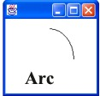
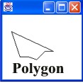
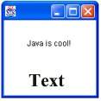
Arc | g.drawArc(35, 45, 75, 95, 0, 90); drawArc(int x, int y, int width, int length, int startAngle, int arcAngle) Used to draw an arc inside an imaginary rectangle whose upper left corner is at (x,y).
Polygon | int [ ] x = {20, 35, 50, 65, 80, 95}; int [ ] y = {60, 105, 105, 110, 95, 95}; g.drawPolygon(x, y, 6); drawPolygon(int x[ ], int y[ ], int n) Used to draw a polygon created by n line segments. The command will close the polygon. (x-coordinates go in one array with accompanying y-coordinates in the other)
String (text) | g.drawString("Java is cool!", 40, 70); drawString(String str, int x, int y); Draws a string starting at the point indicated by (x,y). Be sure you leave enough room from the top of the screen for the size of the font.

Slide 16
The java.awt.Color Class
Instances of the Color class represent colors.
new Color(r, g, b)
where r, g, b are the values of the red, green, and blue components, respectively. They are in the in the range of 0 to 255.
Predefined constants
BLACK ORANGE YELLOW BLUE GREEN PINK CYAN LIGHTGRAY RED DARKGRAY MAGENTA WHITE

Slide 17
The java.awt.Font Class
Fonts are specified with three attributes:
font name: Serif Sans-serif ,Monospaced Times New Roman, Helvetica, Courier etc.
font style: PLAIN,BOLD,ITALIC
Styles can be combined: Font.BOLD|Font.ITALIC
font size: a positive integer
A font can be created as follows:
new Font(name, style, size)

Slide 18
Example…
import java.awt.*;
import java.applet.*;
/* applet code=“Test_Graphics” width=300 height=200></applet> */
public class Test_Graphics extends Applet
{
public void paint(Graphics g)
{
Dimension d = getSize();
g.setColor(Color.BLACK);
g.fillRect(0, 0, d.width, d.height); // paint background
g.setFont(new Font("San-serif", Font.BOLD, 24));
g.setColor(new Color(255, 215,0));
g.drawString("Hello, world!", 60, 40);
g.drawImage(getImage(getCodeBase(), “Rabbit.jpg"),20, 60, this);
}
}
Notes:
Represents graphics context, an abstraction of various drawing surfaces, e.g., screen, printer, off-screen image (an image stored in memory).
Provide a rich set of graphics methods

Slide 19
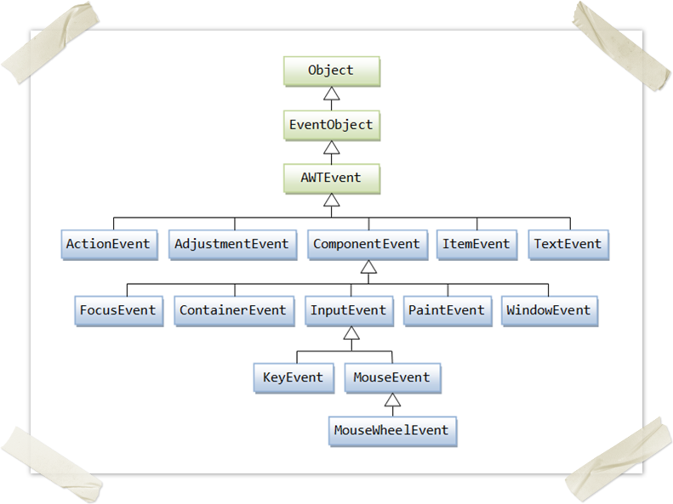

Slide 20


